Slide 1
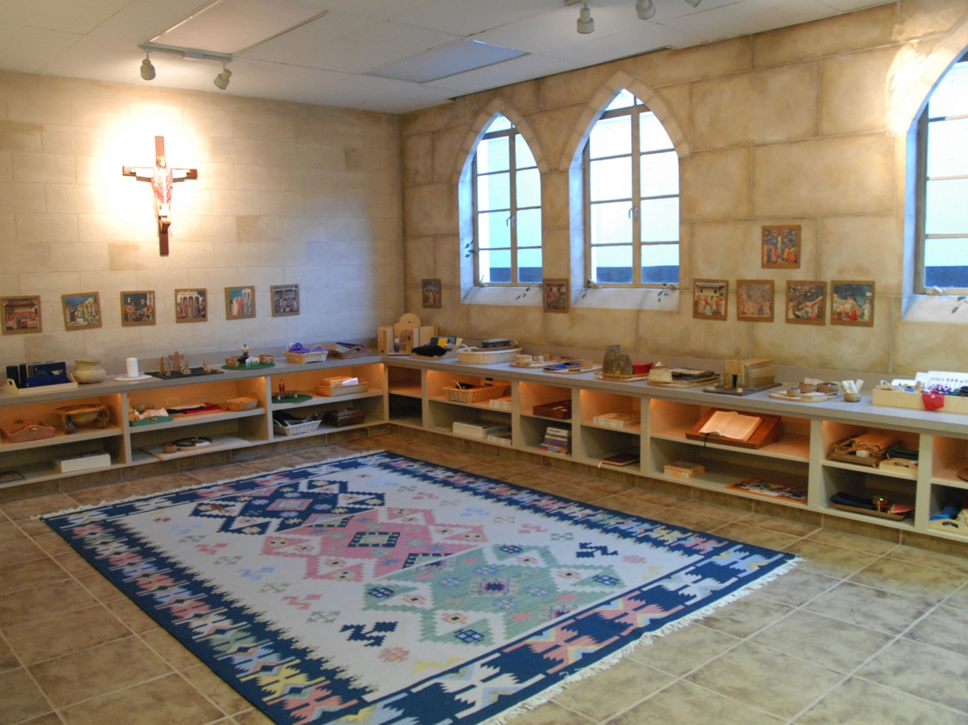
Godly Play Space
Is sacred space

Slide 2
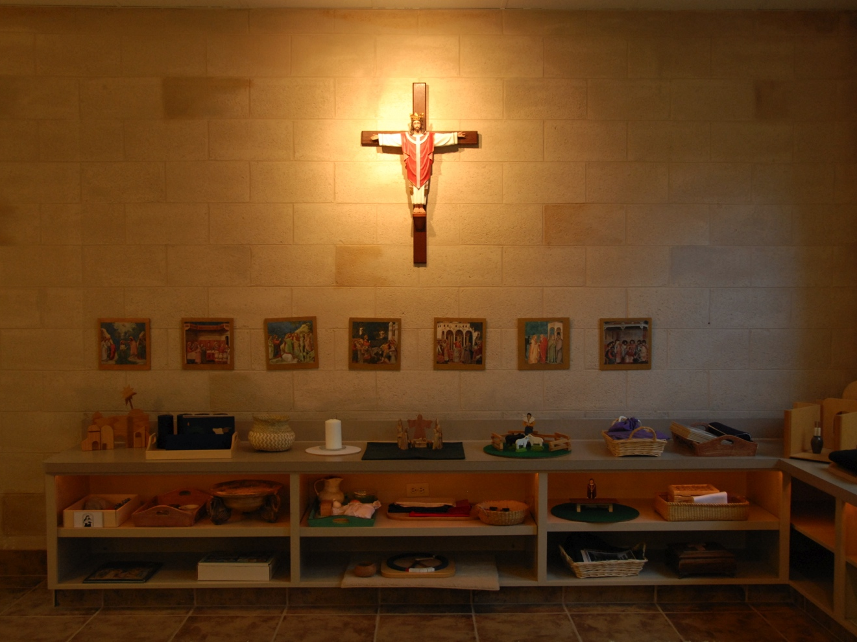
St. John’s Room
All Saints’ Episcopal Church Ft. Worth, TX
Focal Shelf
a room for children ages 3 to 5

Slide 3
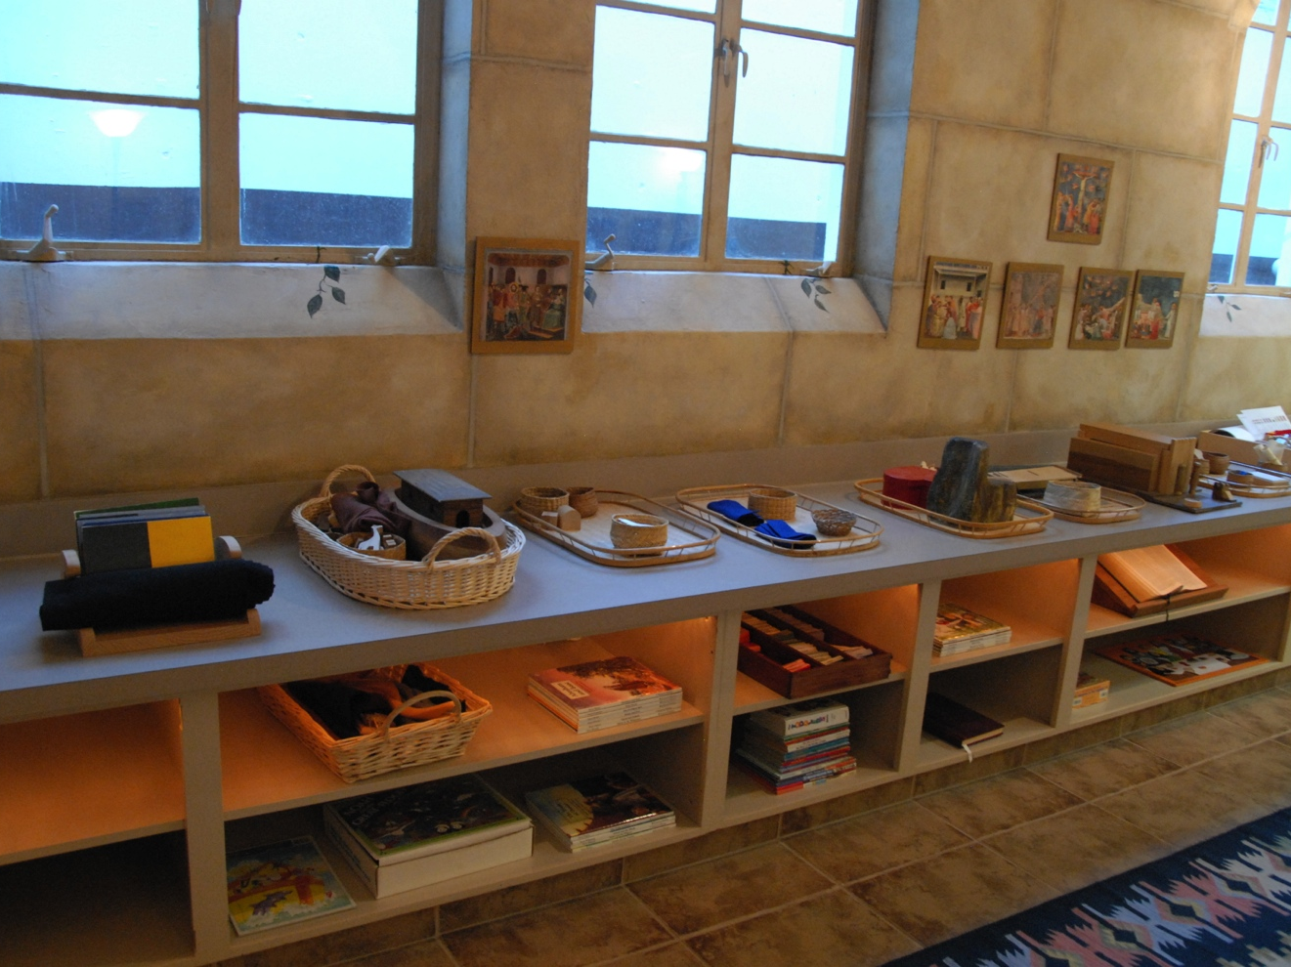
St John’s Room
Sacred Story Shelves

Slide 4
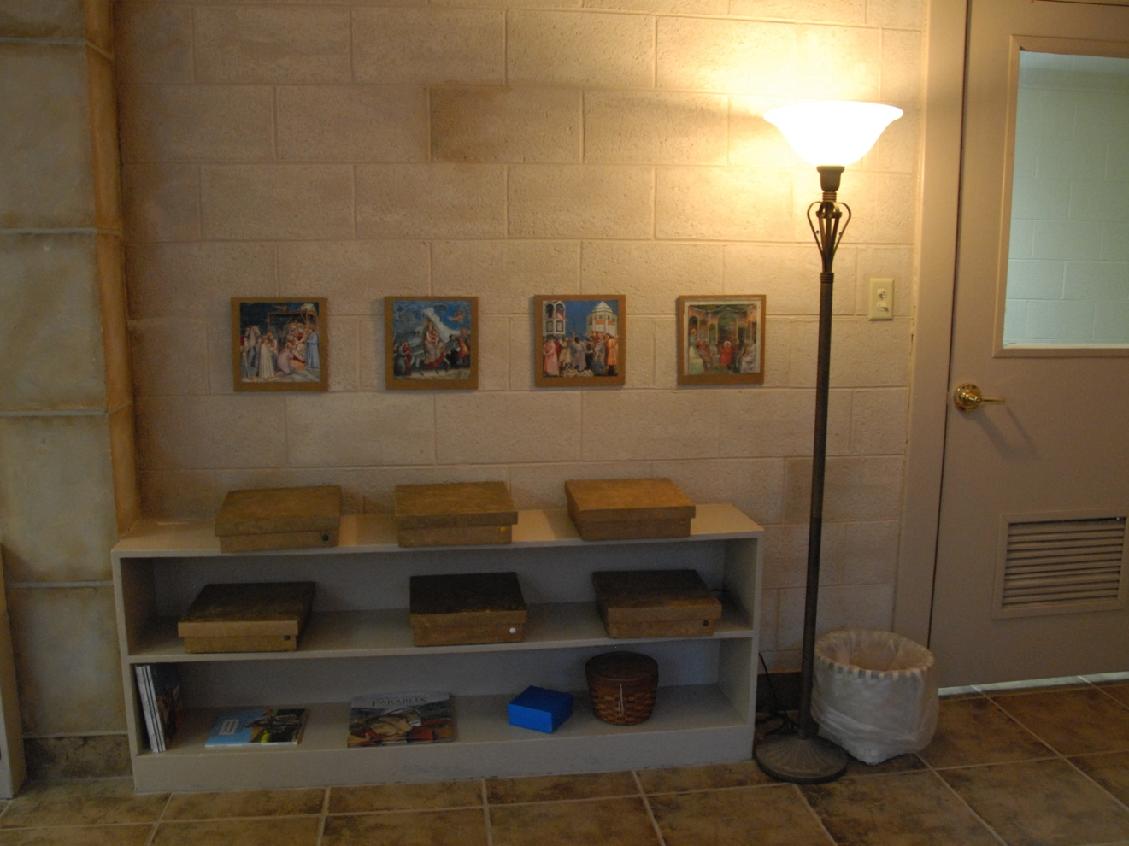
St John’s Room
Parable Shelves

Slide 5
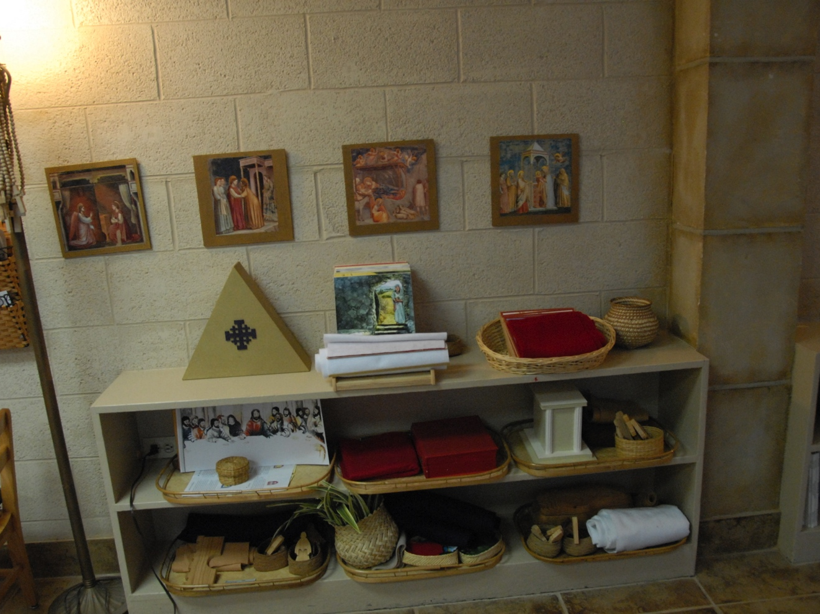
St. John’s Room
Pentecost Shelf

Slide 6
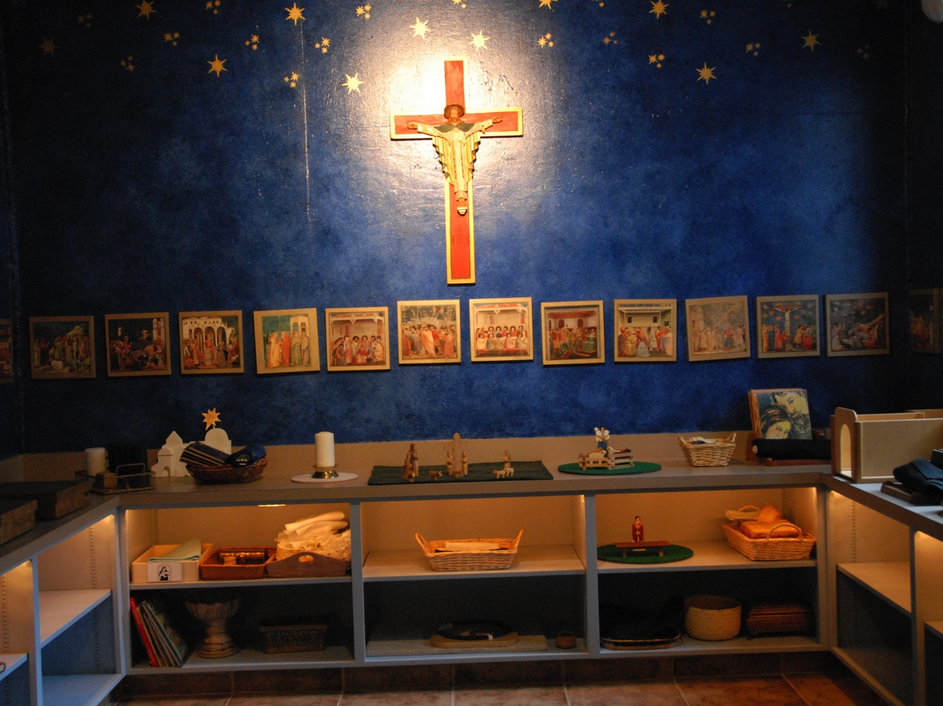
St Luke’s Room
All Saints’ Episcopal Church Ft.Worth, TX
focal shelf
a room for children in Kindergarten and 1st Grade.

Slide 7
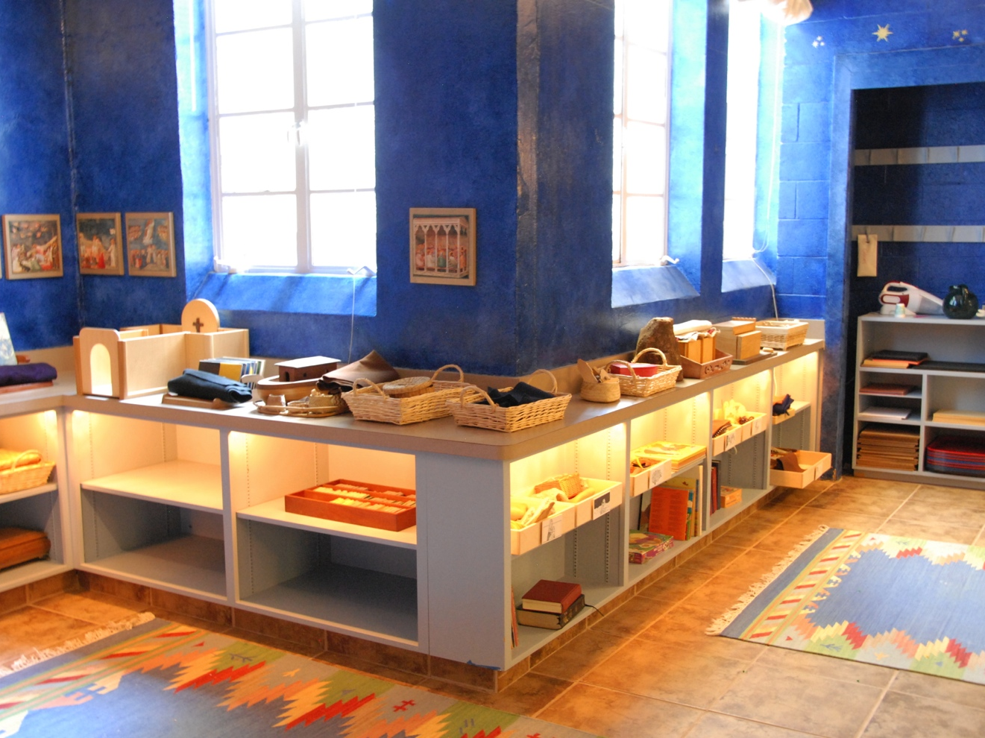
St. Luke’s Room
Sacred Story Shelves

Slide 8
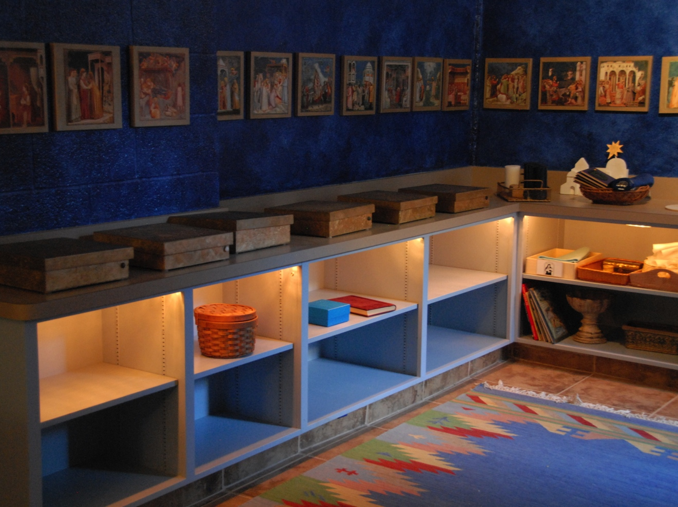
St. Luke’s Room
Parable Shelf

Slide 9
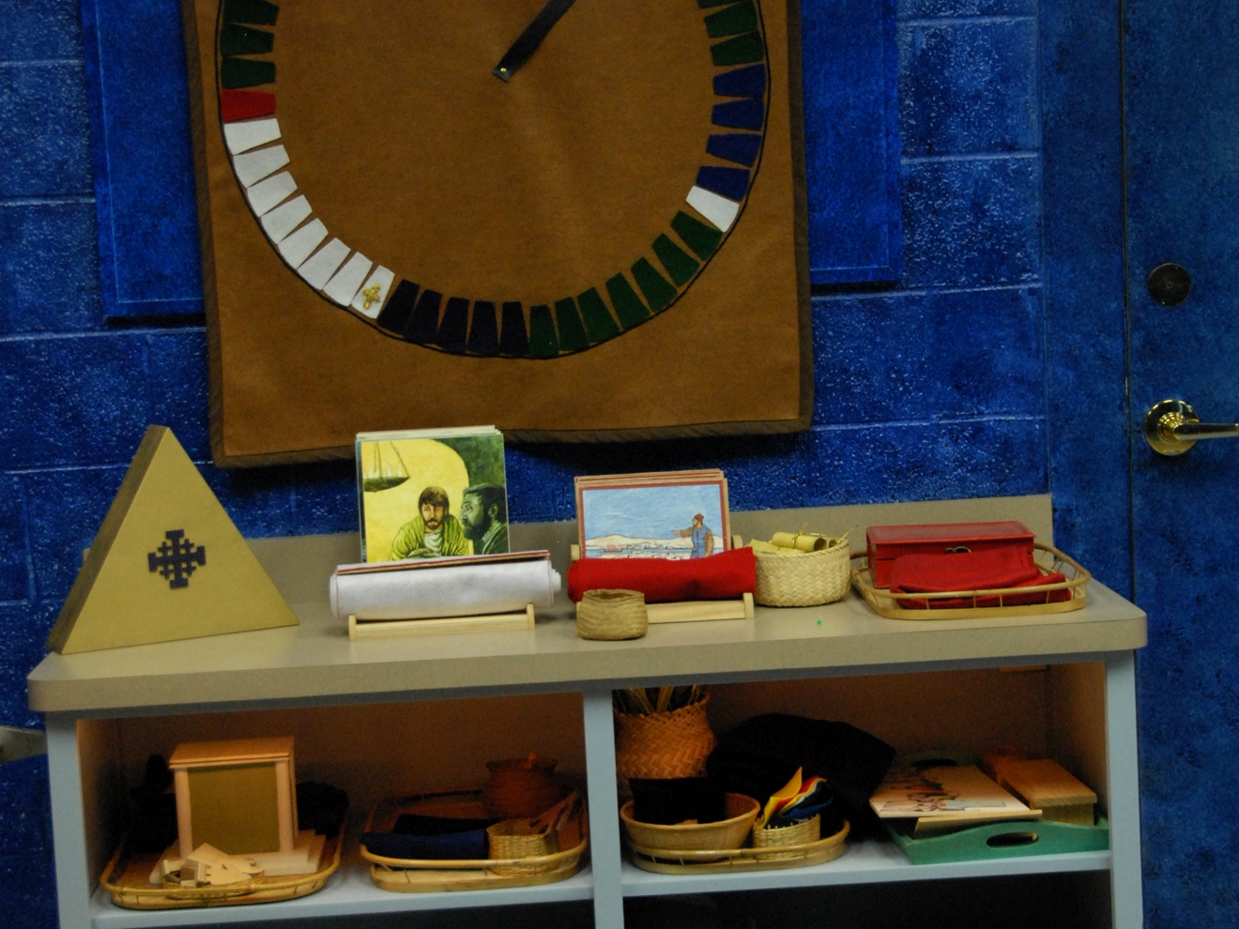
St. Luke’s
Pentecost Shelf

Slide 10
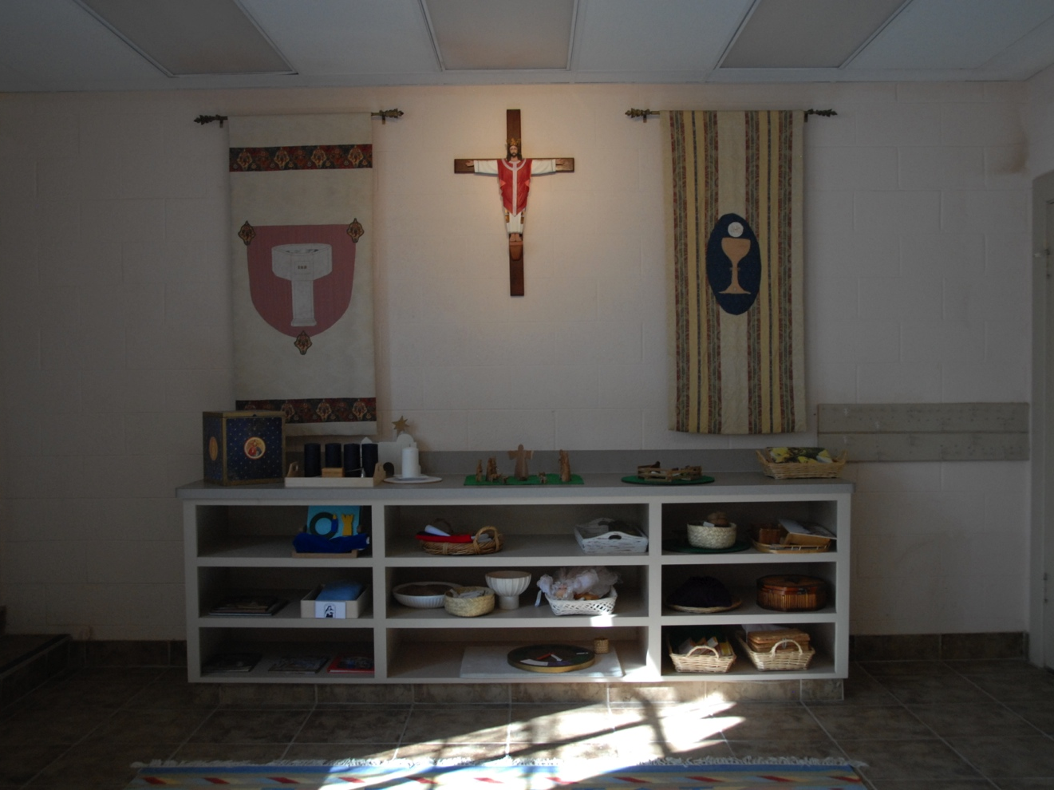
St. Mark’s Room
All Saints’ Episcopal Church Ft. Worth, TX
Focal Shelf St. Mark’s,
a room for children In the 2nd and 3rd Grades

Slide 11
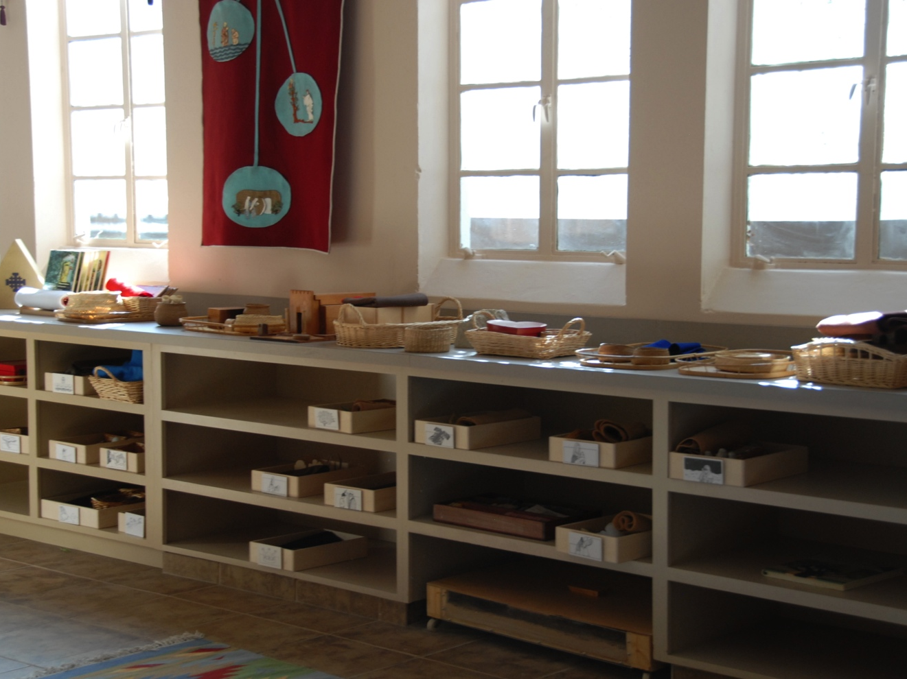
St. Mark’s
Sacred Story and Pentecost Shelves

Slide 12
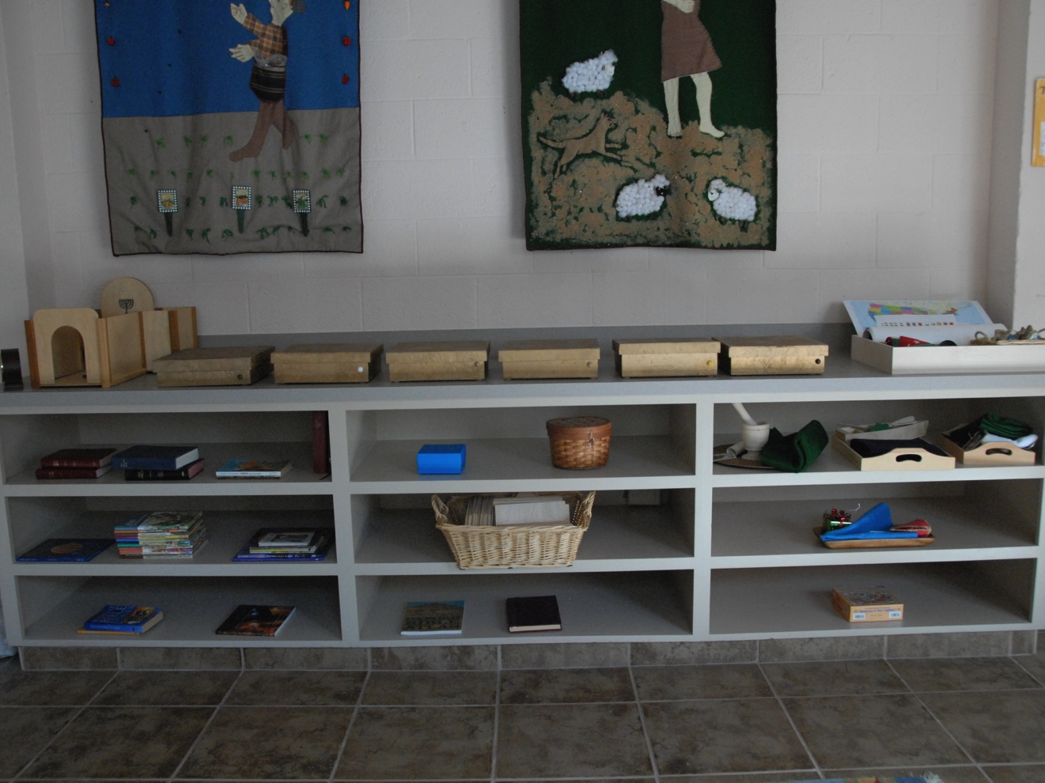
St. Mark’s
Parable Shelves and Saints

